Slide 1
Cross site scripting
Domain: vulnweb.com

Slide 2
Sub-domain: testasp.vulnweb.com
The steps to find the vulnerabilities in this cross site scripting is :
First lets visit the website which is “ https://testasp.vulnweb.com/”.
After that on the top of the menu you will be prompted with the search box.
Now you can intercept the request in the burp suite.
Now you can find the different payloads for XSS.
Next send the request to the intruder and paste all the payloads.
Finally try to find a successful payload for xss and prepare a report for it.

Slide 3
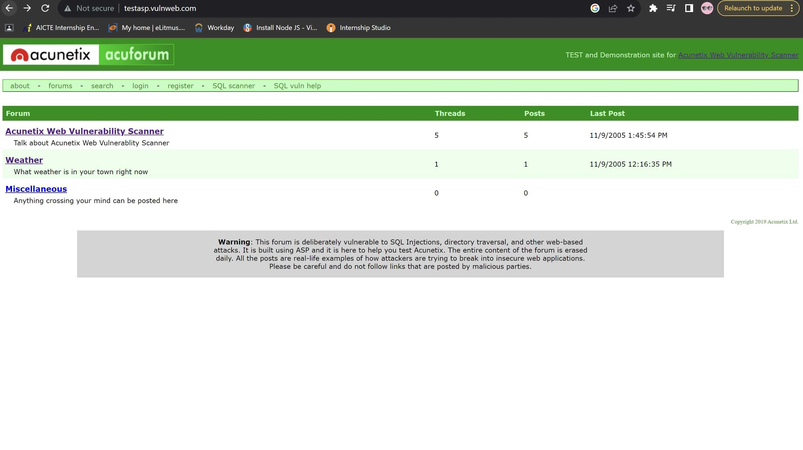
Here are the screenshorts which makes you understand easily.

Slide 4
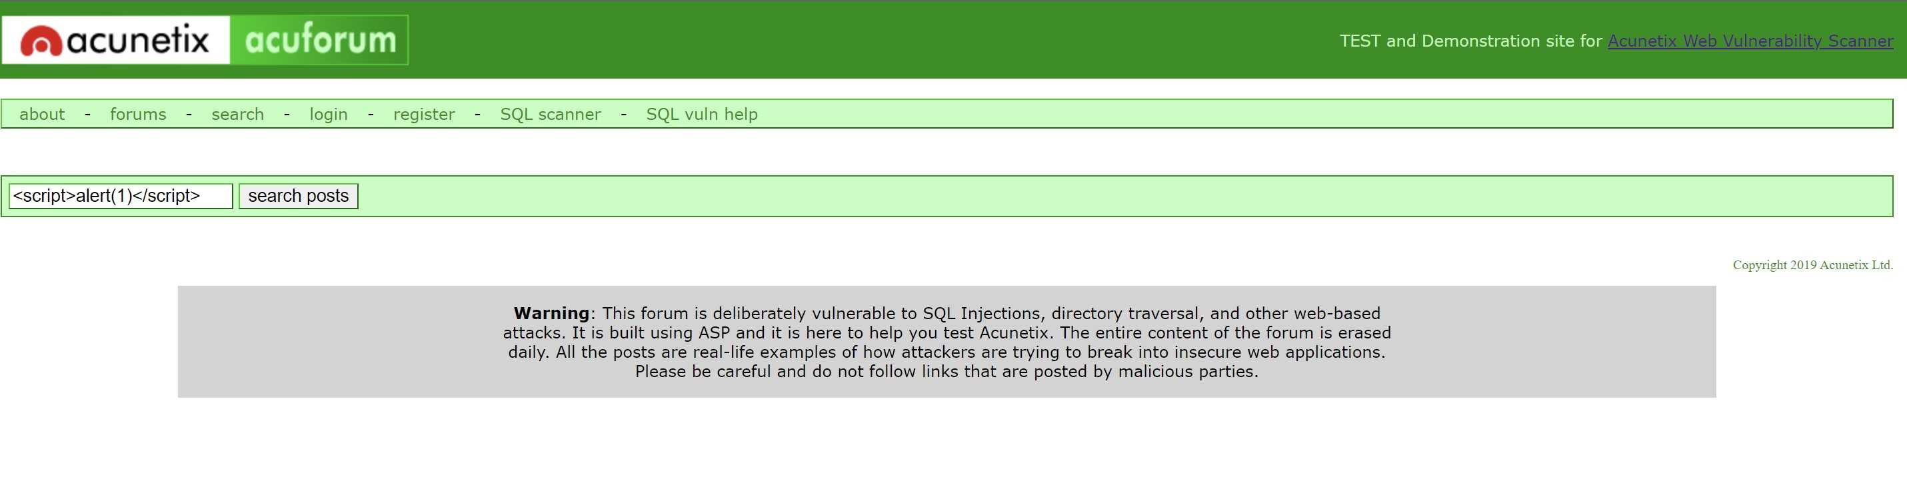

Slide 5
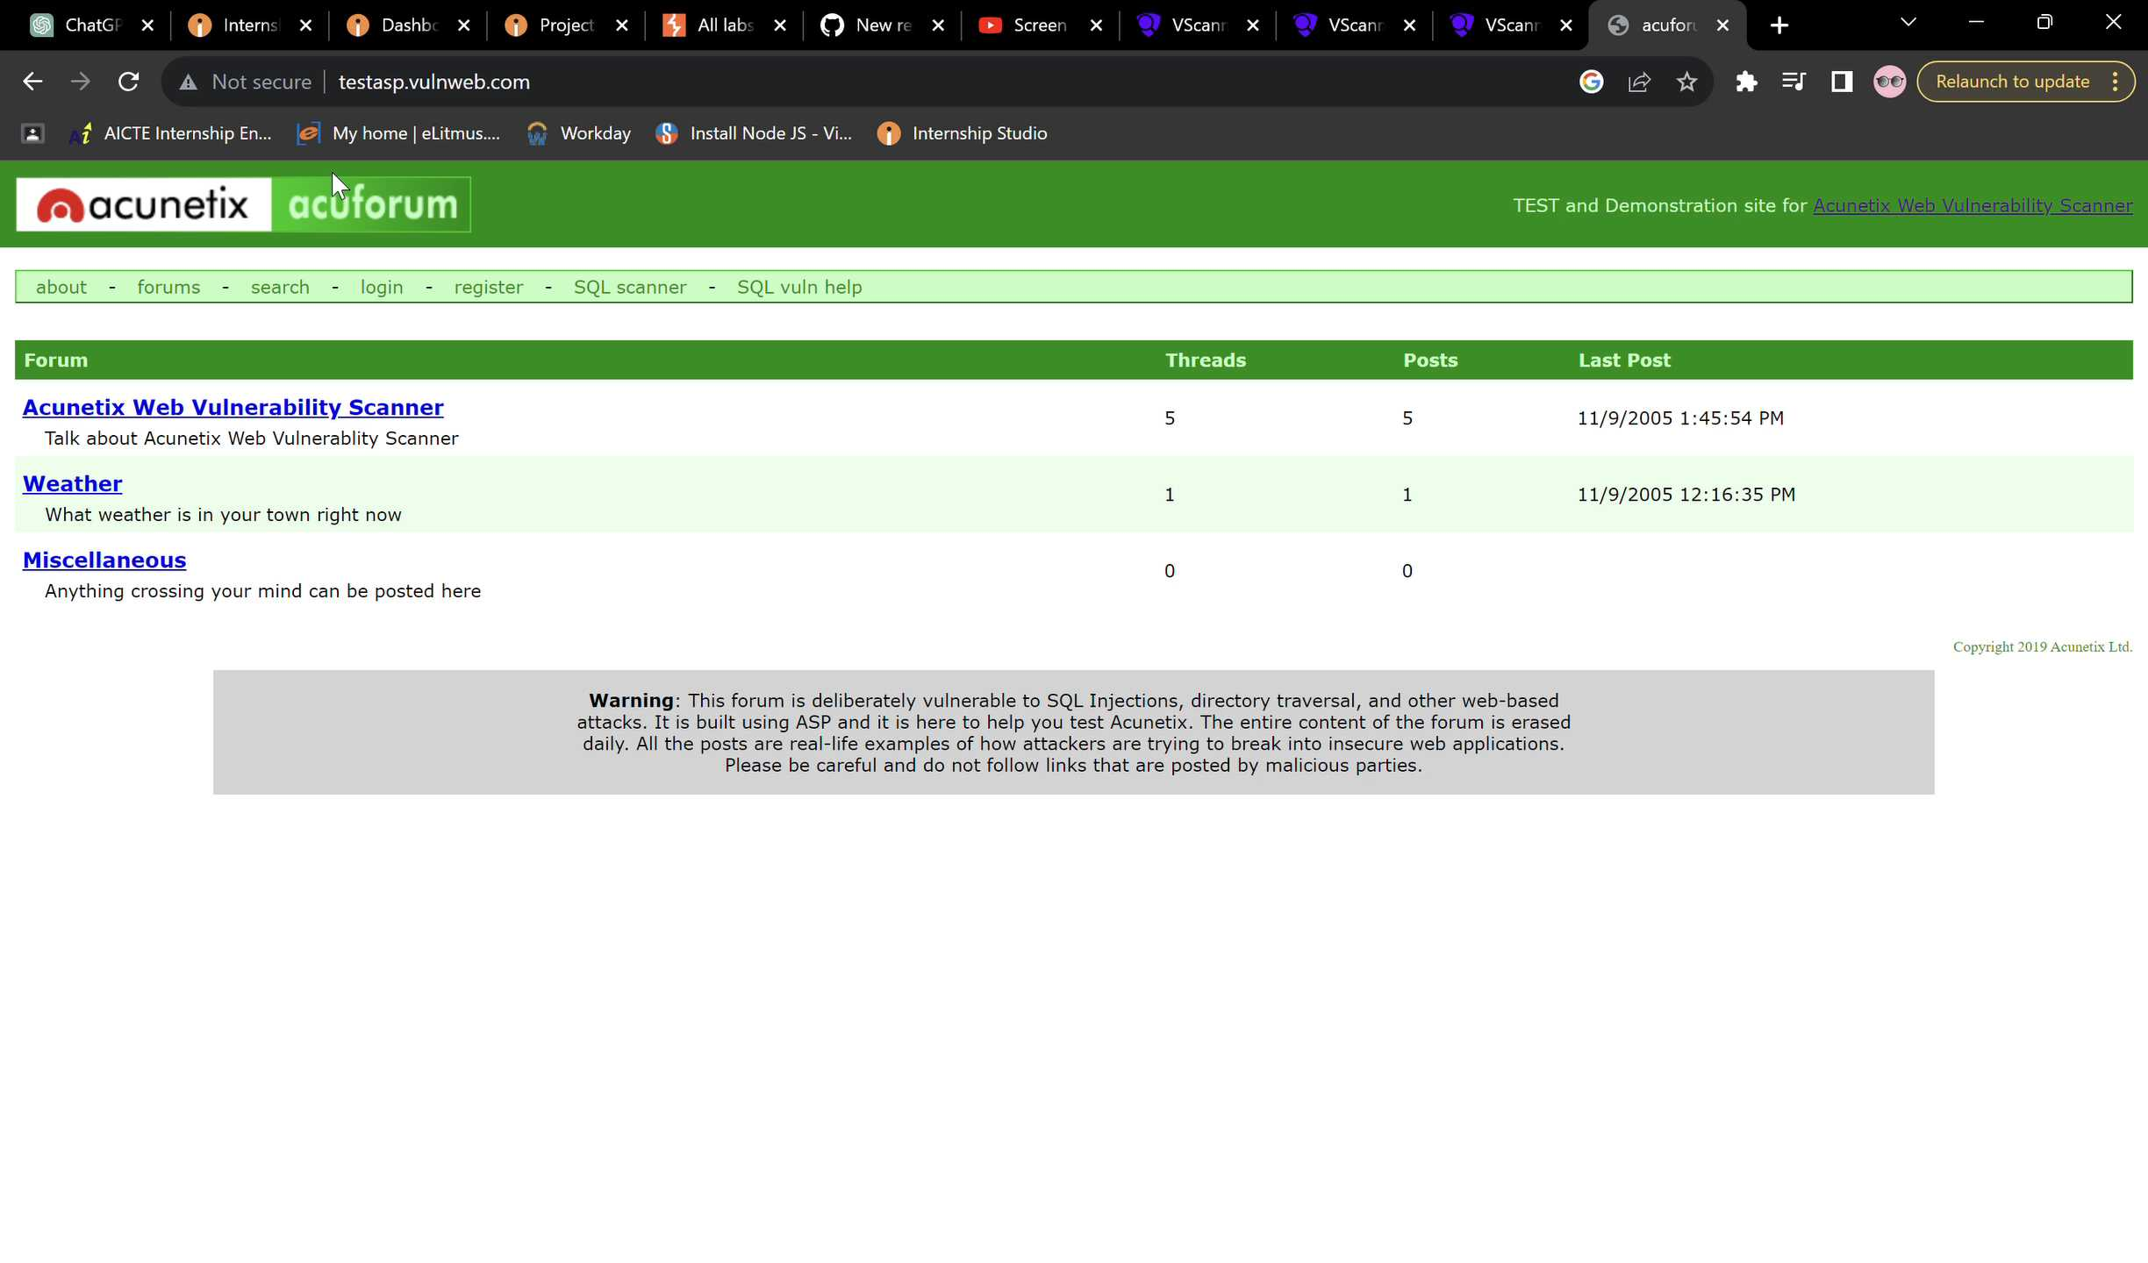
In detailed video recording about how th e payload is given and how the prompts are generated

Slide 6
Impacts: Cross site scripting can leads to steal the users data and also harmful to your website
Mitigation: If you want to prevent your website to be vulnerable from CSS then enable noscript on browser.
Thank you…….

